Slide 1

GUEST LECTURE · AI IN SUPPLY CHAIN MANAGEMENT · UTD SPRING 2026
From idea to
Daily Reality
How Operations Research powers American Airlines’
maintenance supply chain every day
Francisco Zenteno | Operations Research & Advanced Analytics | American Airlines

Slide 2
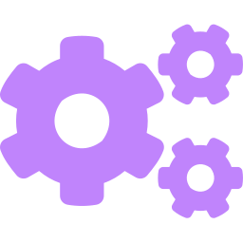



About me
I wear many hats:
Francisco Zenteno
🎓 B.S. Industrial Engineering
M.S. Operations Research
Pontificia Universidad Católica de Chile
🎓 M.S. Computer Science
UC San Diego
💼 Operations Research & Advanced Analytics
American Airlines · Dallas, TX
Operations Research Scientist
Optimization models & algorithms
Software Engineer
TDD, CI/CD, production systems
Product Thinker
Business value & stakeholder alignment
Communicator
Technical ↔ Business translator

Slide 3
Before we start...
Every day, American Airlines flies
1,000 aircraft across 200+ airports.
Mechanics every night need maintenance parts to maintain aircrafts that will arrive at that station.
The maintenance part is there, or it must be brought by some aircraft.
My team decides how to bring those maintenance parts to where they are needed. Every day.

Slide 4
The Problem: a medicine cabinet on wings
Each aircraft carries a curated set of spare parts as it flies its daily route sequence. There is not enough inventory for each of the thousand unique parts everywhere.
Parts
Loaded
City A
City B
Maintenance
Base
▶
▶
▶
At airports
Stop 1
Stop 2
Mechanic waiting
✔ If the part(s) for a specific maintenance task are available when that aircraft arrives, the mechanics can work.
✘ If the part(s) are not there— the plane waits for a shipment, or maintenance is deferred. Sometimes the maintenance is required for the aircraft to continue flying.

Slide 5
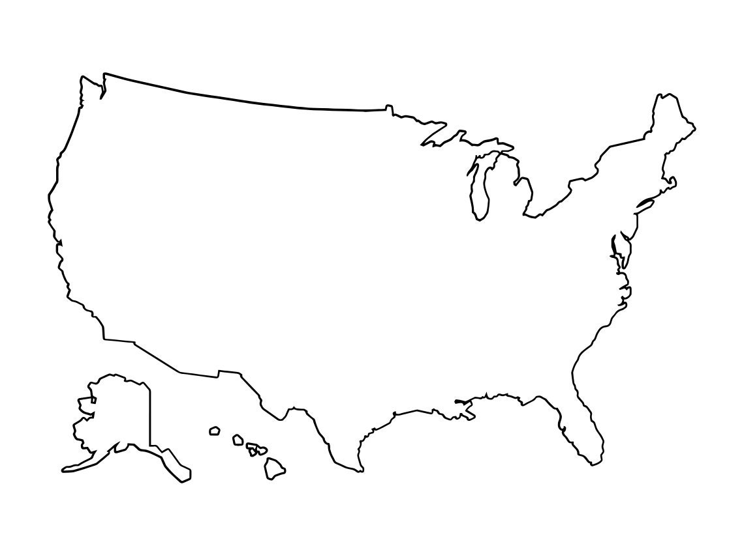
Coordinate the fleet to transport the parts
JFK
The orange aircraft requires the orange part on DFW this night
ORD
IND
LAX
DFW
MIA

Slide 6
Coordinate the fleet to transport the parts
JFK
ORD
IND
LAX
DFW
MIA

Slide 7
The scale of the problem
1,000
200+
25
1,000+
Aircraft
Airports
Maintenance Bases
Part Types
The fleet isn't uniform — it's a family of models, each with unique part requirements:
Narrowbody — Airbus
Narrowbody — Boeing
Widebody — Boeing
A319 · A320 · A321
737NG · 737 MAX
777-200 · 777-300 · 787-8 · 787-9
Some parts shared across models.
Some unique to each variant.
Some parts shared across models.
Some unique to each variant.
Some parts shared across models.
Some unique to each variant.

Slide 8
How hard can it be?
🤔 If you had 30 seconds, what would you do?
💡 Quick answer: "Just figure out what each maintenance base needs, and put those parts on whatever plane is flying there next."
Sounds reasonable. But it fails — for at least three reasons:
1
2
3
You don't know with 100% certainty where each plane will end today.
Aircrafts have weight and space constraints
Some maintenance tasks require a bundle of parts. 1 missing part implies the task can’t be done.
Schedules change. Weather happens. Aircraft swap routes. The future is uncertain.
You cannot load everything onto every plane. Each aircraft type has strict limits.
A maintenance task might need several parts, the mechanics need all of them.

Slide 9

When reality strikes
Even a well-built plan falls apart when the real world intervenes.
Scenario 1: The Storm
Scenario 2: Emergency Reroute
The plan: A plane carrying a critical part departs DFW heading to TUL (Tulsa) maintenance base.
The plan: A part for MIA (Miami) maintenance is already at the airport, waiting for the scheduled aircraft to arrive.
Reality: A storm grounds the plane in OKC. The part never arrives. The mechanic in Tulsa waits. The job is deferred.
Reality: That aircraft was rerouted to cover an emergency elsewhere. A different plane lands at MIA — without the part.
The model assumed the plane would arrive, but it did not.
The right part was in the right city. Just not on the right plane.

Slide 10

The combinatorial complexity
Mixed Integer Programming (MIP)
We need specialized & fast algorithms.
On a given day, at a given hour:
Decisions (variables):
For each aircraft $i$ arriving to a station $s$ carrying parts $p_{1},p_{2},…,p_{n}:$
Which parts should be unloaded on this station?
Which parts should be loaded into its next flights?
Constraints:
Weight/Volume limits on the aircraft to carry parts.
You have a limited time (~1 hour) in the station to load/unload parts to avoid delaying the next flight.
Objective(s):
Maximize the tasks that can be done at each station by end of day.
Minimize the cost of carrying unnecessary weight.
Enumerating all combinations is impossible. MIP algorithms help to solve this problem.
The solver may need to run every 30 minutes.
The run should provide a recommendation in < 5 min so the business can review it.
Business knowledge may be exploited to reduce the search space. Example:
“Don’t allow Airbus aircrafts to carry parts of Boeing aircrafts”.
How to deal with these competing objectives?
Notes:
Assume 1 person is paid by the financial profit of the company. The other is paid by maintenance compliance. Ask them how to solve this issue.

Slide 11
The optimal answer might not be optimal
If the business can’t execute an ‘optimal solution’, then that solution is not optimal for the business
The model approximates the real operation
Reality is uncertain
Human in the loop is needed
We model 95% of the cases, 5% might add unnecessary complexity.
Sometimes an actionable simple solution might be better than a more complex one.
Storms.
Pilot was sick.
Emergency reroutes.
→ Embed this reality from the beginning. It does need to be tackled in the optimization model necessarily.
The business unit is the leader.
The mathematical tools provide recommendations.

Slide 12
An underestimated effort: Data Quality
Garbage in, garbage out
1
2
3
4
Raw Data
Arrives
Validate
& Check
Transform
Solver
Runs
→
→
→
Flight schedules, inventories, locations — from multiple upstream systems, different formats
Is the data consistent? Can I provide a business recommendation with this information?
Build the input structures the optimization solver expects.
The optimization model receives clean, validated, enriched data and produces a recommendation
What if a part's weight arrives as “null” in the data?
Imputing with an estimation might cause the solver to overload an aircraft. The right answer might be instead: talk to data engineering and fix the source — before the model ever runs. Data quality is a team sport.

Slide 13
A team sport
Building a production AI system is a team sport. Every discipline is essential.
OR Scientists
Software Engineers
Design optimization models & algorithms
Build production-grade, tested code
Maintenance Experts
The
System
Ops & SCM Experts
Domain knowledge the model must respect
Business constraints & stakeholder alignment
Data Engineers
Product Owners
Build & maintain the data pipelines
Define success criteria & prioritize the roadmap
"The OR scientist who can't talk to the maintenance expert will build the wrong model.
The developer who doesn't understand the business will build the right system for the wrong problem."

Slide 14
Thanks
Questions?

